Slide 1
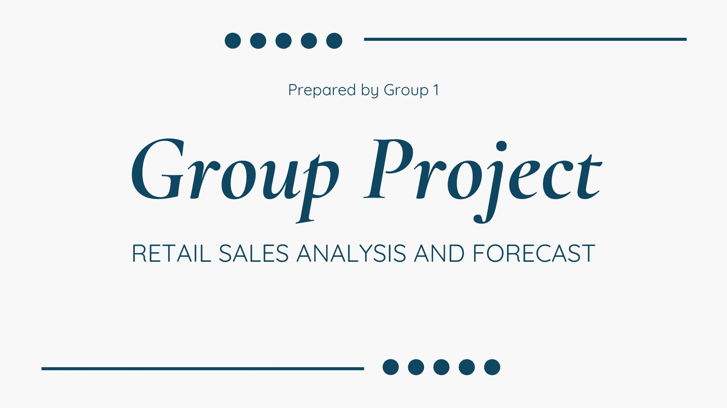

Slide 2

Develop a predictive model that categorizes transactions into specific groups for better analysis and decision-making
Uncover hidden patterns in customer behavior to create targeted marketing strategies
Use predictive analysis to enhance sales forecasting

Slide 3
EXPLORATORY DATA ANALYSIS (EDA)
Best-Selling Products
Top product: Paper Craft Little Birdie (80,995 units sold).
Second: Medium Ceramic Top Storage Jar (78,033 units).
Third: World War 2 Gliders Asstd Designs (54,855 units).
Top 10 Revenue-Generating Products
Top product: Dotcom Postage ($206,248.77 revenue).
Second: Regency Cakestand 3 Tier ($174,131.04 revenue).
Third: Paper Craft Little Birdie ($168,469.60 revenue).
Number of Transactions Per Country
United Kingdom: 18,019 transactions.
Germany: 457 transactions.
France: 392 transactions.
Total Revenue Per Country
United Kingdom: $9,001,855.17
Netherlands: $285,446.34
EIRE: $283,170.52

Slide 4
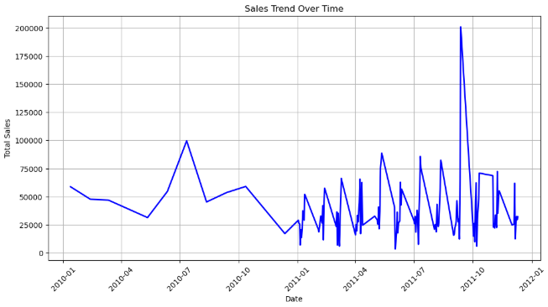
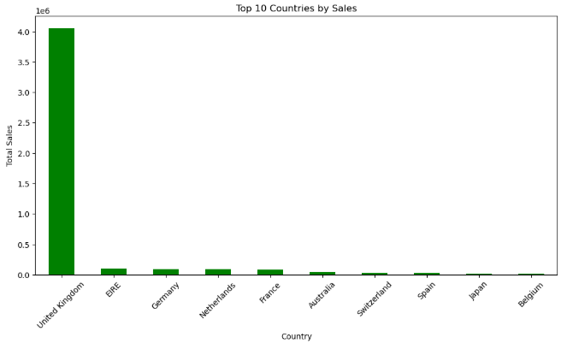
VISUALIZATION OF EXPLORATORY DATA ANALYSIS

Slide 5
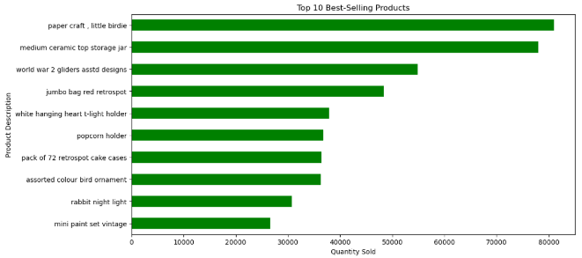
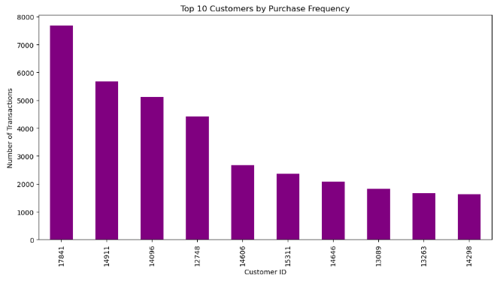
VISUALIZATION OF EXPLORATORY DATA ANALYSIS

Slide 6
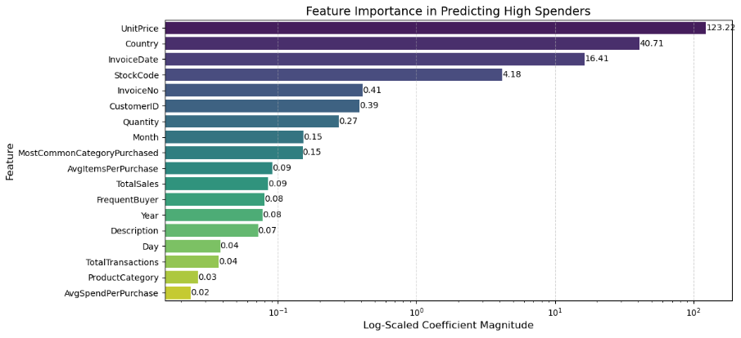
SUMMARY
This chart highlights the key factors influencing high-spending customers.
Unit Price is the strongest predictor, indicating that customers who purchase expensive items tend to spend more while country also plays a major role, suggesting that location-based factors like pricing and availability impact spending behavior. Invoice Date shows that timing affects purchasing trends, likely due to seasonal sales or promotions.
Other moderate impact features include Stock Code, Invoice Number, and Customer ID, which help capture transaction and spending patterns while Lesser influential features, such as Total transaction, Product Category and Avg Spend Per Purchase, have minimal predictive power.
key take away include:
Optimize pricing strategies to attract high-value customers.
Leverage regional insights to tailor marketing efforts. Time promotions effectively based on seasonal trends.
Feature Importance in Predicting High Spenders

Slide 7
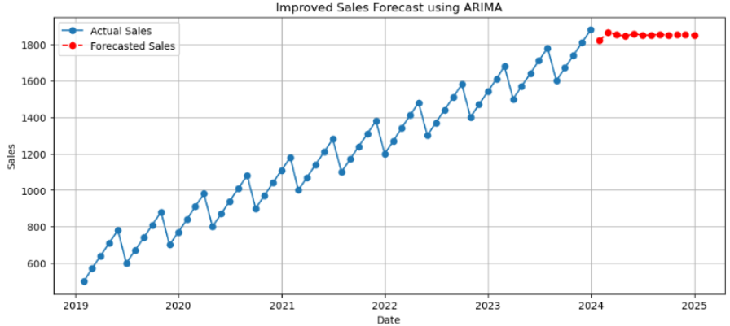
Sales Forecasting using ARIMA
SUMMARY
Actual Sales Trend (Blue Line): The historical sales data shows an upward trend with seasonality, meaning sales have been increasing consistently over time.
There are visible fluctuations, possibly due to seasonal demand changes or external factors affecting sales.
Forecasted Sales (Red Dots)The ARIMA model predicts steady sales growth but at a slightly stabilized rate.

Slide 8
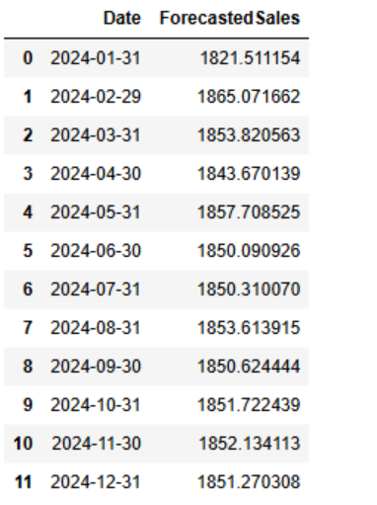
Sales Forecasting using ARIMA
Key Observations:
Steady growth, fluctuating around 1,850 - 1,865 units.
February sees the highest sales (1,865 units).
No drastic spikes or drops.

Slide 9

RECOMMENDATIONS
Inventory Optimization: Given the steady growth in sales, businesses should ensure sufficient stock levels to meet demand, particularly in February, which sees a slight peak.
Pricing Strategy: Unit Price has the highest impact on high spenders. Businesses should experiment with pricing strategies to maximize revenue without discouraging purchases.
Geographical Expansion: The UK dominates in transactions and revenue, but potential growth opportunities exist in Germany and France.
Targeted Promotions: Customers with high AvgSpendPerPurchase and frequent transactions should be targeted for loyalty programs and exclusive offers.
Product Strategy: High revenue-generating products should be prioritized in marketing and inventory planning.
Seasonal Adjustments: Peak sales months (Nov-Dec) should be leveraged with promotional campaigns to maximize revenue.

